Slide 1
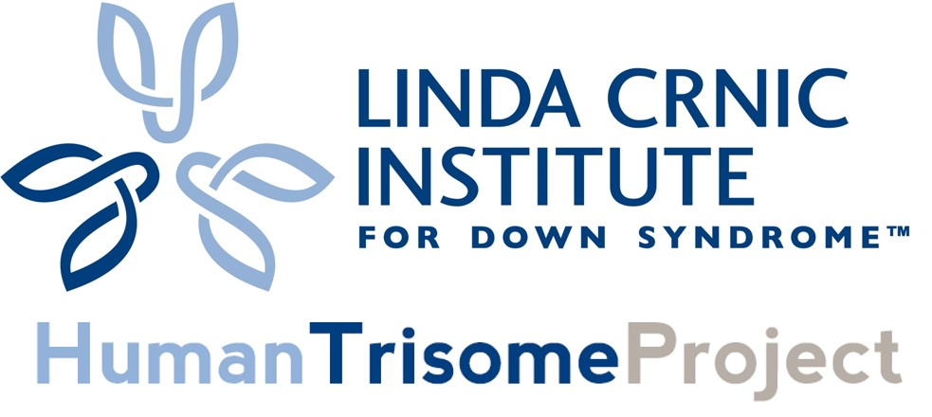


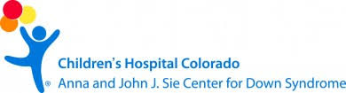

Consideración en la participación en la investigación clínica
Keith Smith y Kate Waugh
keith.smith@ucdenver.edu & katherine.waugh@ucdenver.edu
Linda Crnic Instituto del Síndrome de Down
T21RS Conferéncia International 2019: Barcelona
June 8th, 2019
Notes:
Hello, my name is Keith Smith and I am presenting today, with my wife, Kate. We work together as researchers in the lab of Joaquin Espinosa at the Linda Crnic Institute for Down syndrome.
Emphasis: Research scientists family members of an individual who happens to have Down syndrome.

Slide 2

Nuestra mission de investigación:
Ayudar a la gente con syndrome de Down a vivir una vida más sana y feliz
Hermano
Cuñada
Randy
Notes:
Scientists with a family member who happens to have Down syndrome
Give an overview of Randy.

Slide 3

Cada persona con el síndrome de Down esta lidiando en una forma única y personal
Son más impresionantes que diferentes!

Slide 4

Individuos con síndrome de Down
tiene alteraciones en la incidencia de la enfermedad
Enfermedad de Alzheimer
Infecciones
Respiratorias
Severas
Leusemia
Autoinmunity
Autismo
Sueno Obstructivo
Enfermedades del
corazón
Tumores Solidos
Ataque al corazón
De >400,000 Americanos con Trisomia 21 puede contener soluciones a las principales condiciones medicas.
Notes:
Individuals with trisomy of chromosome 21 (T21), the molecular cause of Down syndrome, experience an altered disease spectrum compared to the typical (D21) population. For example, while T21 predisposes to various autoimmune disorders, Alzheimer’s disease, leukemias, pulmonary hypertension, and severe respiratory infections, T21 also protects individuals from most solid tumors.
The immune system has been established in the typical population as a key modulator of many of the medical conditions displaying altered incidence in T21.
However, there is a dearth of studies regarding the immune system in adults with T21.
Therefore, investigations of immune dysregulation in adults with T21 could significantly improve the lives of these people as well as those of the typical population afflicted with these co-morbidities.
High rates of respiratory infections
Anatomical v. immune deficiency
Autoimmunity
Celiac disease
Hypothyroidism
Type I diabetes mellitus
Alopecia areata
Transient myeloproliferative disease
Leukemia
AML
ALL
Collectively responsible for considerable morbidity & mortality
http://www.intellectualdisability.info/physical-health/articles/the-immune-system-in-downs-syndrome
http://www.globaldownsyndrome.org/about-down-syndrome/history-of-down-syndrome/down-syndrome-human-and-civil-rights-timeline/
http://www.ncbi.nlm.nih.gov/pubmed/23432468
Autoimmune disease. People who develop a particular inflammatory disorder known as Hashimoto's thyroiditis have the most common cause of hypothyroidism.
Celiac disease = gluten then small intestine infammation
Pancreas
Skin
Thrombocytopenia is a condition in which you have a low blood platelet count.
Transient myeloproliferative disorder (TMD)
Acute myeloid leukemia (AML)
Acute megakaryoblastic leukemia (AMKL)
Visit about obvious ones with the immune system. And say has been cited about immune system differences.
Make sure to learn which viral infections up and which ones down to elaborate on with IFNs
Down syndrome (DS), caused by the presence of three copies of chr21, is the most common chromosomal abnormality in the human population (approximately 1 in 700 live births) (1). Individuals born with trisomy 21 (T21) endure intellectual disabilities, heart defects, hearing impairments, and other health problems. Interestingly, while T21 strongly predisposes individuals to many diseases such as Alzheimer’s disease, leukemia, and autoimmune disorders, evidence also suggests that this genetic disorder protects them from other diseases such as solid tumors (1-6). Despite the potential for studies of T21 to positively impact those with T21, as well as many among the general population who also suffer from these diseases, mechanisms underlying the protective and harmful effects of T21 on disease susceptibility are poorly understood.
Down syndrome, caused by the presence of three copies of chr21, is the most common chromosomal abnormality in the human population (approximately 1 in 700 live births) (1). Individuals born with Trisomy 21 (T21) endure intellectual disabilities, heart defects, hearing impairments, and other health problems. Interestingly, while T21 strongly predisposes individuals to many diseases such as Alzheimer’s disease, leukemia, and autoimmune disorders, evidence also suggests that this genetic disorder protects them from other diseases such as solid tumors (1-6). For instance, T21 children have a 10- to 20-fold increased risk of leukemia, particularly B cell precursor acute lymphoblastic leukemia (B-ALL) (7, 8). Despite the potential for studies of T21 to positively impact those with T21, as well as many among the general population who also suffer from these diseases, mechanisms underlying the protective and harmful effects of T21 on disease susceptibility are poorly understood.
Visit about obvious ones with the immune system. And say has been cited about immune system differences.
Make sure to learn which viral infections up and which ones down to elaborate on with IFNs
Down syndrome (DS), caused by the presence of three copies of chr21, is the most common chromosomal abnormality in the human population (approximately 1 in 700 live births) (1). Individuals born with trisomy 21 (T21) endure intellectual disabilities, heart defects, hearing impairments, and other health problems. Interestingly, while T21 strongly predisposes individuals to many diseases such as Alzheimer’s disease, leukemia, and autoimmune disorders, evidence also suggests that this genetic disorder protects them from other diseases such as solid tumors (1-6). Despite the potential for studies of T21 to positively impact those with T21, as well as many among the general population who also suffer from these diseases, mechanisms underlying the protective and harmful effects of T21 on disease susceptibility are poorly understood.
Down syndrome, caused by the presence of three copies of chr21, is the most common chromosomal abnormality in the human population (approximately 1 in 700 live births) (1). Individuals born with Trisomy 21 (T21) endure intellectual disabilities, heart defects, hearing impairments, and other health problems. Interestingly, while T21 strongly predisposes individuals to many diseases such as Alzheimer’s disease, leukemia, and autoimmune disorders, evidence also suggests that this genetic disorder protects them from other diseases such as solid tumors (1-6). For instance, T21 children have a 10- to 20-fold increased risk of leukemia, particularly B cell precursor acute lymphoblastic leukemia (B-ALL) (7, 8). Despite the potential for studies of T21 to positively impact those with T21, as well as many among the general population who also suffer from these diseases, mechanisms underlying the protective and harmful effects of T21 on disease susceptibility are poorly understood.
Down syndrome, caused by the presence of three copies of chr21, is the most common chromosomal abnormality in the human population (approximately 1 in 700 live births) (1).
Individuals born with trisomy 21 endure intellectual disabilities, heart defects, hearing impairments, and other health problems.
Interestingly, while T21 strongly predisposes individuals to many diseases such as Alzheimer’s disease, leukemia, and autoimmune disorders, evidence also suggests that this genetic disorder protects them from other diseases such as solid tumors.
Despite the potential for studies of T21 to positively impact those with T21, as well as many among the general population who also suffer from these diseases, mechanisms underlying the protective and harmful effects of T21 on disease susceptibility are poorly understood.
High rates of respiratory infections: Anatomical v. immune deficiency
Autoimmunity
Celiac disease
Hypothyroidism
Type I diabetes mellitus
Alopecia areata
Transient myeloproliferative disease
Leukemia
AML
ALL
Collectively responsible for considerable morbidity & mortality

Slide 5
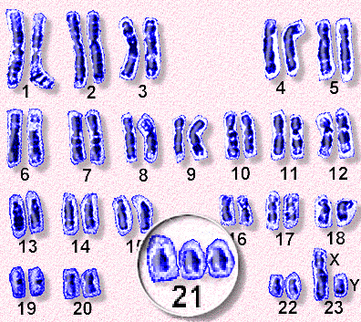
Trisomia 21, la molecula que produce el síndrome de Down, se define en 3 copias del cromosoma 21 en vez de 2
http://www.sbs.utexas.edu/sanders/bio309/Lectures/2006/Lecture%208%202006.htm

Slide 6




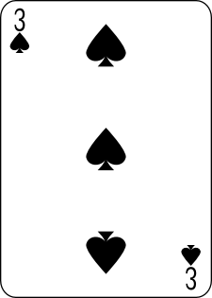
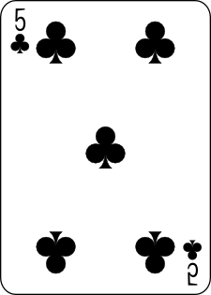
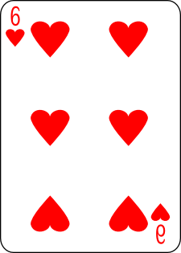
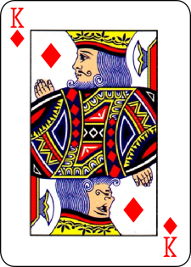
Sabemos muy poco sobre como
trisomía 21 causa el síndrome de Down
Trisomia 21
Sindrome
Down
Enfermedad
Celíaca
Atresias
Intestinal
Disfunción
Tiroidea
Defectos
Cardiacos
Congénitos
Convulsiones
Leucemia
Autismo
~5%
~12%
un 18%
un 13%
~1%
40-50%
un 10%
Notes:
The unfortunate reality is we know very little about how this third copy of chr21 ultimately leads to the condition known as DS, from the hallmark developmental phenotypes, intellectual disability, and this different disease spectrum. The field has largely focused on studying chr21 genes, of which there are 200-300, for decades, but we still have this black box where we don’t understand how we get from point A to point B. So we wanted to take an unbiased approach to try to open up this black box and understand what causes this different disease spectrum in people with DS. Our thinking is that if we can decipher this, we can hugely benefit not only the 400K people with DS in the US, but also millions of other typical people affected by ALL of these conditions which are clearly somehow modulated by the presence of an extra copy of chr21.

Slide 7
Qué son los ensayos y estudios clínicos?
Las investigaciones Clínicas son estudios los cuales envolucran gente vs. otros animals o sistemas celulares.
Dos tipos: studios de observación y estudios de ensayos clínicos.
  Estudios de obsevación, observa gente en un ambiente normal sin ninguna intervención. Estos estudios ayudan a identificar nuevos y posibles ensayos.
  Ensayos clinicos son investigaciones hechas con personas orientadas a evaluar una intervención. Esta es la forma principal en que los investigadores descubren algunos tratamientos.
https://www.nia.nih.gov/health/what-are-clinical-trials-and-studies
Notes:
We can also list the obvious if useful – nothing that hurts, could harm or is impossible!

Slide 8
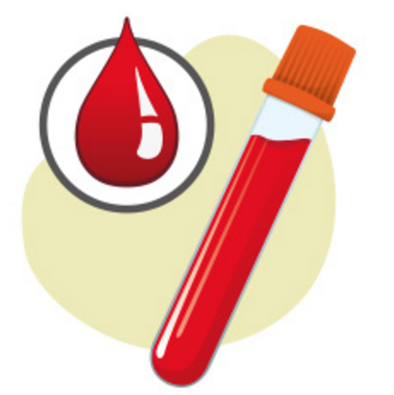
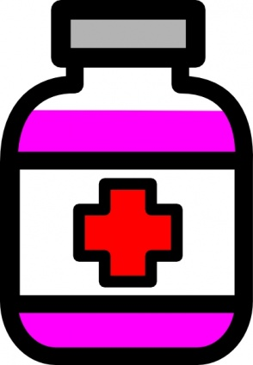
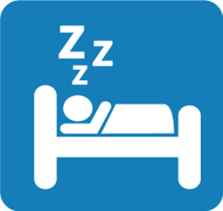
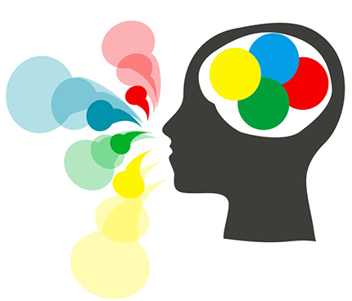
Cualquier persona puede participar en una amplia variedad de estudios clínicos.
Tratamiento
Extracción de sandre
Estudio del sueño
Intervención del habla
Notes:
Using HTP example as an entry point explain there is a huge spectrum of research types that people can participate in – from giving blood/samples to participating in a study looking at evidence-based speech interventions for preschool children with DS to participating in a clinical trial where you take drugs/placebo etc.

Slide 9
Por qué las personas participan en estudios clínicos?
Para ayudarse a si mismos / persona con síndrome de down directamente– ya sea ahora o en el future.
  Puede recibir un nuevo tratamiento para una enfermedad antes de que esté disponible para todos los demás.
  Desempeñar un papel más activo en su propia atención médica.
Los investigadores pueden brindarle atención médica y exámenes de salud más frecuentes como parte de su tratamiento.
Puede ayudar a otros a obtener un mejor tratamiento para sus problemas de salud en un futuro.
https://www.nia.nih.gov/health/what-are-clinical-trials-and-studies
Notes:
For this audience it is very important to emphasize there are essentially TWO reasons people generally participate:
(1) To help themselves/person with DS directly – either now or in the future
(2) To pay it forward and help people in the future

Slide 10
Por qué las personas participan en estudios clínicos?
Para ayudarse a si mismos / persona con síndrome de down directamente– ya sea ahora o en el future.
  Para tartar una dolencia o enfermedad existente.
  Para prevenir una dolencia o enfermedad.
  Para desempeñar un papel más activo en su atención médica.
  Los investigadores pueden brindarle atención médica y revision médicas más frecuentes como parte de su tratamiento.
Paga el tratamiento ayudando a las personas en el futuro.
  Puede ayudar a otros a obtener un mejor tratamiento para sus problemas de salud en un futuro
https://www.nia.nih.gov/health/what-are-clinical-trials-and-studies
Notes:
For this audience it is very important to emphasize there are essentially TWO reasons people generally participate:
(1) To help themselves/person with DS directly – either now or in the future
(2) To pay it forward and help people in the future

Slide 11
Cómo elegir qué ensayo clínico es adecuado para usted?
Calidad de
vida
Más
atención
médica
Duración
De la vida
Costo y riesgo
Beneficio potencial
Balance
https://www.nia.nih.gov/health/clinical-trials-benefits-risks-and-safety
Notes:
The new treatment may cause serious side effects or be uncomfortable.
The new treatment may not work, or it may not be better than the standard treatment.
You may NOT be part of the treatment group (or experimental group) that gets the new treatment—for example, a new drug or device. Instead, you may be part of the control group, which means you get the standard treatment or a no-treatment placebo.
The clinical trial could inconvenience you. For example, medical appointments could take a lot of time. You might need to travel to the study site several times or stay in the hospital.

Slide 12
Cómo elegir qué ensayo clínico es adecuado para usted?
Face
Effectos
secundarios
Calidad de
vida
Impactos
psicologicos
Impactos
en la family
Más
atención
médica
Duración
De la vida
Costo y riesgo
Beneficio Potencial
Balance
https://www.nia.nih.gov/health/clinical-trials-benefits-risks-and-safety
Notes:
The new treatment may cause serious side effects or be uncomfortable.
The new treatment may not work, or it may not be better than the standard treatment.
You may NOT be part of the treatment group (or experimental group) that gets the new treatment—for example, a new drug or device. Instead, you may be part of the control group, which means you get the standard treatment or a no-treatment placebo.
The clinical trial could inconvenience you. For example, medical appointments could take a lot of time. You might need to travel to the study site several times or stay in the hospital.

Slide 13
Fase III de ensayo: recopila más información sobre seguridad y eficacia, estudia diferentes poblaciones y diferentes dosis, y usa el medicamento en combinación con otros medicamentos. El número de sujetos suele oscilar entre varios cientos y alrededor de 3.000 personas. Si la FDA acepta que los resultados del ensayo son positivos, aprobará el medicamento o dispositivo experimental.
Los ensayos clínicos de fármacos suelen descripción en función de su fase.
Para medicamentos o dispositivos se lleva a cabo después de que la FDA aprueba su uso. La efectividad y seguridad de un dispositivo o medicamento se monitorean en poblaciones grandes y diversas. A veces, los efectos secundarios de un medicamento pueden no ser claros hasta que más personas lo hayan tomado durante un período de tiempo más prolongado.
Ensayo face I: Probar un tratamiento experimental en un pequeño grupo de personas (20 to 80) a menudo sanas para juzgar su seguridad y efectos secundarios y para encontrar la dosis correcta del medicamento.
Ensayo face II: Usar mas personas (100 to 300). Mientras que el énfasis en la fase I es la seguridad, el énfansis en la fase II está en la efectividad. Esta face tiene como objetivo obtener datos preliminares sobre si el medicamento functiona en personas que tienen una enfermedad o condición determinada. Estos ensayos También continúan estudiando la seguridad, incluidos los efectos secundarios a corto plazo. Esta face puede durar varios años.
Ensayo face III: Recopila más información sobre la seguridad y eficacia, estudia diferentes poblaciónes y diferentes dosis, y usa el medicamento en combinación con otros medicamentos. El número de sujetos suele oscilar entre varios cientos y alrededor de 3,000 personas. Si la FDA acepta que los resultados del ensayo sean positivos, aprobará el medicamento o el dispositivo experimental.
Ensayo face IV: Los medicamentos o dispositivos se lleva a cabo despues de que la FDA aprueba su uso. La efectividad y seguridad de un dispositivo se monitorean en poblaciónes grandes y diversas. Aveces, los efectos secundarios de un medicamento pueden no ser claros hasta que más personas lo hayan tomado durante un periodo de tiempo más prolongado.
Notes:
Clinical trials of drugs are usually described based on their phase. The FDA typically requires Phase I, II, and III trials to be conducted to determine if the drug can be approved for use.
A Phase I trial tests an experimental treatment on a small group of often healthy people (20 to 80) to judge its safety and side effects and to find the correct drug dosage.
A Phase II trial uses more people (100 to 300). While the emphasis in Phase I is on safety, the emphasis in Phase II is on effectiveness. This phase aims to obtain preliminary data on whether the drug works in people who have a certain disease or condition. These trials also continue to study safety, including short-term side effects. This phase can last several years.
A Phase III trial gathers more information about safety and effectiveness, studying different populations and different dosages, using the drug in combination with other drugs. The number of subjects usually ranges from several hundred to about 3,000 people. If the FDA agrees that the trial results are positive, it will approve the experimental drug or device.
A Phase IV trial for drugs or devices takes place after the FDA approves their use. A device or drug's effectiveness and safety are monitored in large, diverse populations. Sometimes, the side effects of a drug may not become clear until more people have taken it over a longer period of time.

Slide 14
Cómo elegir qué ensayo clínico es adecuado para usted?
Calidad de
vida
Placebo
Impactos
Psicologicos
Impactos
en la familia
Más
Atención
médica
Duración
de la vida
Costo y riesgo
Beneficio Potencial
Balance
https://www.nia.nih.gov/health/clinical-trials-benefits-risks-and-safety
Notes:
You may NOT be part of the treatment group (or experimental group) that gets the new treatment—for example, a new drug or device. Instead, you may be part of the control group, which means you get the standard treatment or a no-treatment placebo.
The clinical trial could inconvenience you. For example, medical appointments could take a lot of time. You might need to travel to the study site several times or stay in the hospital.

Slide 15
Cómo elegir qué ensayo clínico es adecuado para usted?
Instituto Crnic Proyecto Trisoma HumanoTM
Estudio de observación mínimamente invasiva de la población con síndrome de Down que emplea tecnologia multi-omicas para el análisis de varias muestras biológicas.
Costo y & riesgo
Benecio Potencial
Balance
https://www.nia.nih.gov/health/clinical-trials-benefits-risks-and-safety

Slide 16
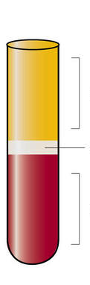
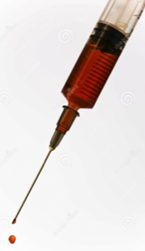
Instituto Crnic Proyecto Trisoma HumanoTM (www.trisome.org)
Extraccion de
sangre
Fracciones de
sangre
Notes:
He has also donated blood once a year to the HTP.
The HTP is a large cohort study of the population with Down syndrome that employs cutting-edge multi-omics technologies for the analysis of various biological samples.
Our family believes in this project so much that we’ve actually all donated.

Slide 17

Crnic Institute Human Trisome ProjectTM (www.trisome.org)
The Power of Multidimensional Datasets
Blood
draw
Blood
fractions
Going beyond the blueprint
Please visit poster #PO157 tonight for more details!
Notes:
He has also donated blood once a year to the HTP.
The HTP is a large cohort study of the population with Down syndrome that employs cutting-edge multi-omics technologies for the analysis of various biological samples.
Our family believes in this project so much that we’ve actually all donated.

Slide 18
Instituto Crnic Proyecto Trisoma HumanoTM
(www.trisome.org)
Objetivos generales:
  1. Definir cómo la trisomía 21 causa un nuevo espectro de enfermedades.
  2. Para acelerar significativamente la investigación sobre síndrome de Down.
  3. Para desarrollar herramientas diagnóstivas y terapéuticas novedosas que beneficiarán las personas con trisomía 21, y tambien a millones de personas típicas .
Notes:
Focusing on the Crnic Institute HTPTM (which is trademark name in full) you may want to consider having a check list that it is minimally invasive if at all, what it is doing and could do for people with DS…
Really lay out our goal: to significantly improve the quality of life and the longevity of life.
Aspirational
Actual: we don’t know. Here are the factors that will make or break us (maybe we don’t get enough people enrolled).

Slide 19
Instituto Crnic Proyecto Trisoma HumanoTM (www.trisome.org)
Metas a corto plazo:
  1. Para completar el estudio más completo de una población de individuos con trisomía 21 hasta la fecha.
  2.Para crear la mayor base de datos pública para la investigación del síndrome de Down hasta la fecha.
  3.Para crear el biobanco más completo de muestras biológicas para la investigación del síndrome de Down. Para tratar una dolencia ecológica o enfermedades.
Notes:
Focusing on the Crnic Institute HTPTM (which is trademark name in full) you may want to consider having a check list that it is minimally invasive if at all, what it is doing and could do for people with DS…
Really lay out our goal: to significantly improve the quality of life and the longevity of life.
Aspirational
Actual: we don’t know. Here are the factors that will make or break us (maybe we don’t get enough people enrolled).

Slide 20
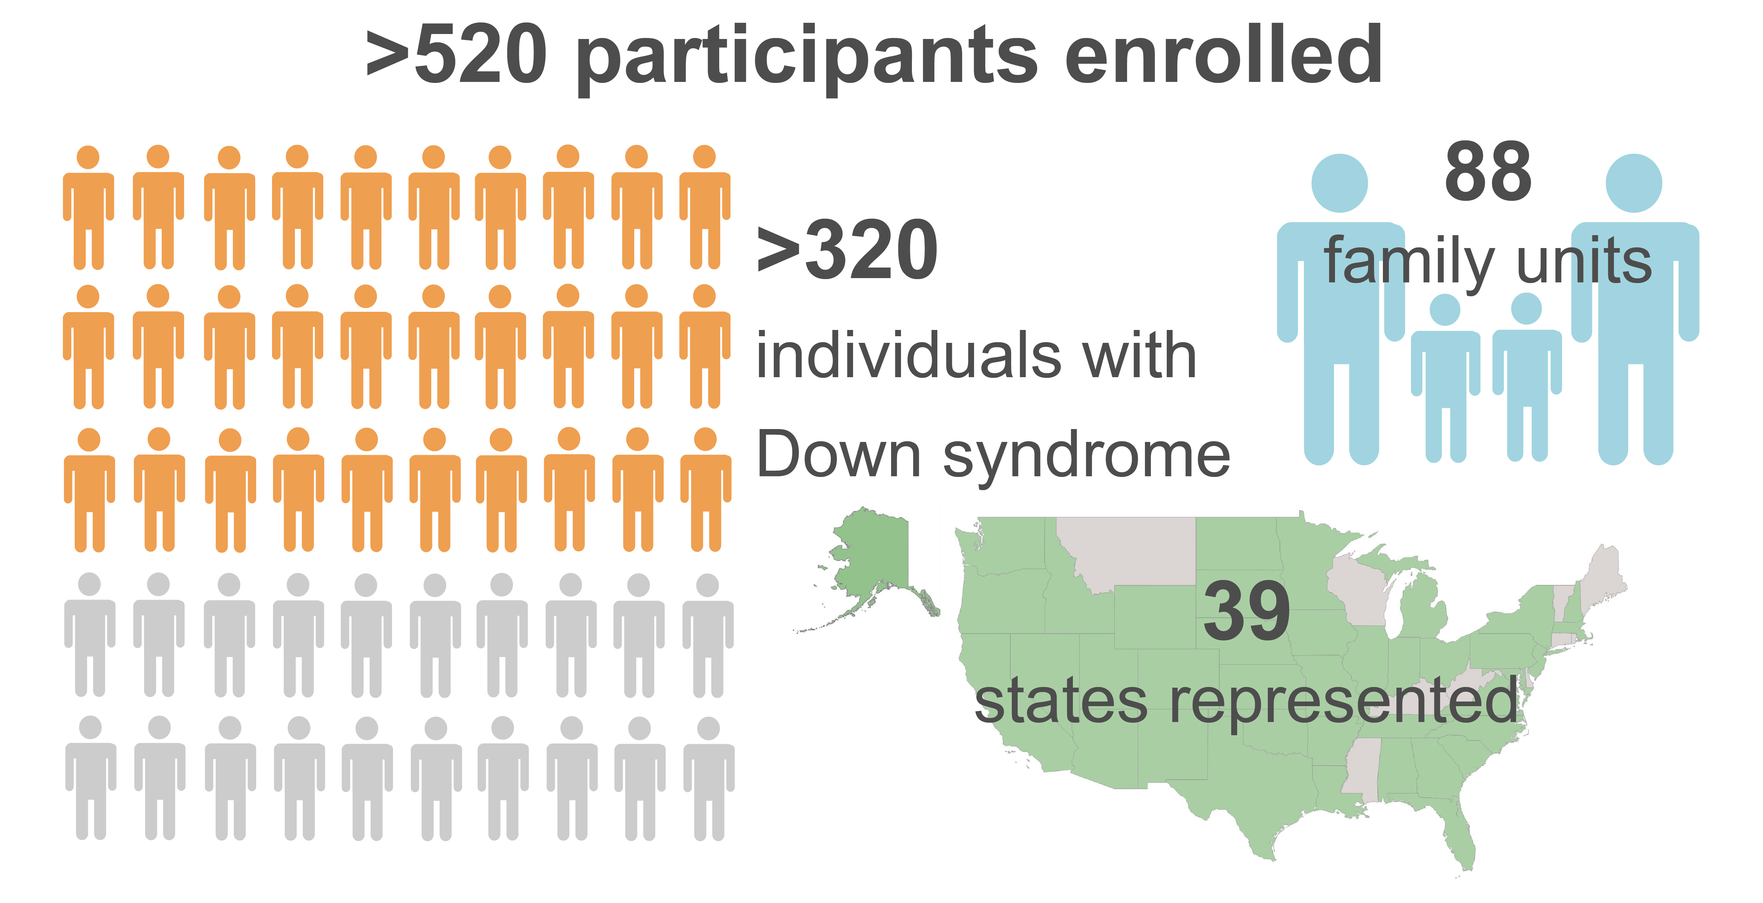
Instituto Crnic Proyecto Trisoma HumanoTM (www.trisome.org)
Notes:
In the HTP how many people with DS have participated? Why? To what end?
Cerebral spinal fluid: from Barcelona. Goals for international.

Slide 21
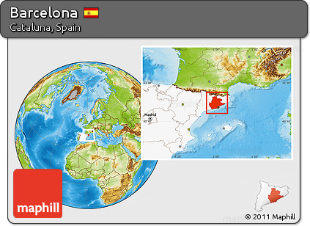
Instituto Crnic Proyecto Trisoma HumanoTM (www.trisome.org)
Notes:
In the HTP how many people with DS have participated? Why? To what end?
Cerebral spinal fluid: from Barcelona. Goals for international.
Laia Munoz Llahuna * juan fortea ormaechea >300 CSF samples of disomic people with and without alzheimers

Slide 22
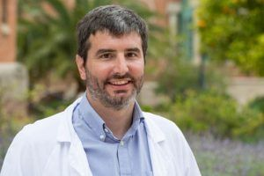
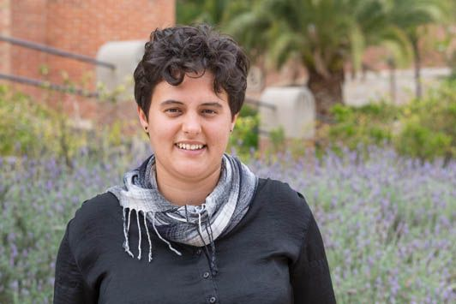
Instituto Crnic Proyecto Trisoma HumanoTM (www.trisome.org)
Down Alzheimer Barcelona Neuroimaging Initiative (DABNI)
Dr. Juan Fortea Ormaechea
Laia Munoz Llahuna
100 muestras de líquido cefalorraquídeo
315 muestras de plasma adicionales
Notes:
In the HTP how many people with DS have participated? Why? To what end?
Cerebral spinal fluid: from Barcelona. Goals for international.
Laia Munoz Llahuna * juan fortea ormaechea >300 CSF samples of disomic people with and without alzheimers
100 CSF samples 50 ctrls, 50 DS
315 plasma samples from DS people, their plasma
All subjects that are in DABNI (DS alzhemiers Barcelona neuroimaging initiative)

Slide 23
Cómo encontrar estudios clínicos relevantes?
Pregúnte a su médico u otros recursos locales
Sitios en la red
  Clinicaltrials.gov.
    Por ejemplo, buscamos “enfermedades de Alzhiemer, Síndrome de Down en los Estados Unidos” encontrará 9 estudios relevantes.
  DSConnect.nih.gov
    Conectate con investigadores y proveedores de salud.
    DSConnect.nih.
  Pregunta a los científicos en esta conferencia internacional.
Notes:
It would be great to list the types of research on DS Connects as a real-life example of the diversity of research going on in the US – I was kind of disappointed. Didn’t think showed a whole lot of diversity but I am used to looking at other kinds of clinical trials from my thesis. Not very diverse compared to other fields… especially for how diverse our population is.
We can also list the obvious if useful – nothing that hurts, could harm or is impossible!
The Horizon21 European Down Syndrome Consortium
There are ethical issues similar to those concerning prevention trials in sAD and ADAD populations, including starting treatments in a healthy population who may not develop dementia for several years. It is therefore vital to understand the “preclinical” (i.e., at risk but before development of signs and symptoms) and “prodromal” (i.e., above a threshold on certain biomarkers, with some cognitive impairment or behavioral changes, but before dementia diagnosis) stages of AD in DS to better predict when to start preventive treatment, as well as to provide data for efficient trial designs. Such data have, until recently, been lacking in DS; however, over the past 5 years, we have been focusing on exploiting clinical, cognitive, fluid biomarker, and imaging data from several DS longitudinal cohorts across Europe to address these gaps in knowledge (see section “The Horizon21 European Down Syndrome Consortium” below), while the NIH has recently funded two DS AD biomarker cohorts in the US (Neurodegeneration in Aging Down Syndrome and Alzheimer's Disease in Down Syndrome).
LuMind RDS Launches a Down Syndrome Clinical Trial Consortium Planning Effort
December 28, 2017 | By Marly Chevrette
Categories: Blog, News, Other
The initial focus will be on Alzheimer’s disease in adults with Down syndrome.

Slide 24
Un total de 7 estudios clínicos estan reclutando en DS Connect
2 Estudios de envejecimiento y Alzheimer en síndrome de Down: El consorcio de ensayos clínicos Alzheimer (Dr. Michael Rafii).Estudios clínicos para identificar biomarcadores del envejecimiento y seguimiento y progreso de Alzheimer.
Registro de participantes de incapacitadades intelectuales de la Universidad de Alabama: Registro local para ayudar a los participantes a encontrar investigaciones relevantes en language, aprendizaje y la memoria que son areas de bajo riezgo para participantes y organizaciones sin ánimo de lucro.
Desarrollo del cerebro en niños en edad escolar con síndrome de Down, estudios a .través de una resonancia magnética cerebral y evaluación del comportamiento/desarrollo.
Desarrollo del cerebro en bebés con síndrome de Down, estudios a .través de una resonancia magnética cerebral y evaluación del comportamiento/desarrollo.
Patrones de comportamiento en incapacidades del Desarrollo en Condiciones Genéticas: El studio en la red esta explorando los tipos de comportamiento que los niños muestran a lo largo del dia en la casa, escuela y la comunidad. Uno de los objetivos del estudio es crear una nueva herramienta que se puede usar en estudios futuros para medir mejor si el tratamiento es efectivo para niños con enfermedades genéticas y de desarrollo.
La relacion entre Ansiedad y el Comportamiento Repetitive y Restringido en Adolescents con Síndrome de Down: Estudia la relacion entre el comportamiento y la salud mental en los niños con syndrome de Down.
Stay tuned: LuMind RDS has recently launched a Down syndrome Clinical Trial Consortium Planning effort.
Notes:
I think it is very important to actually list all the clinical trials available to families on DS Connect. I believe this will include research that is not necessarily sample based or basic science but could include speech, educational, gait/treadmill use, etc that are very interesting.
(1) What ones would you be interested in for Randy? Why? What ones would you not be interested in? Why?
Jean DelBar

Slide 25
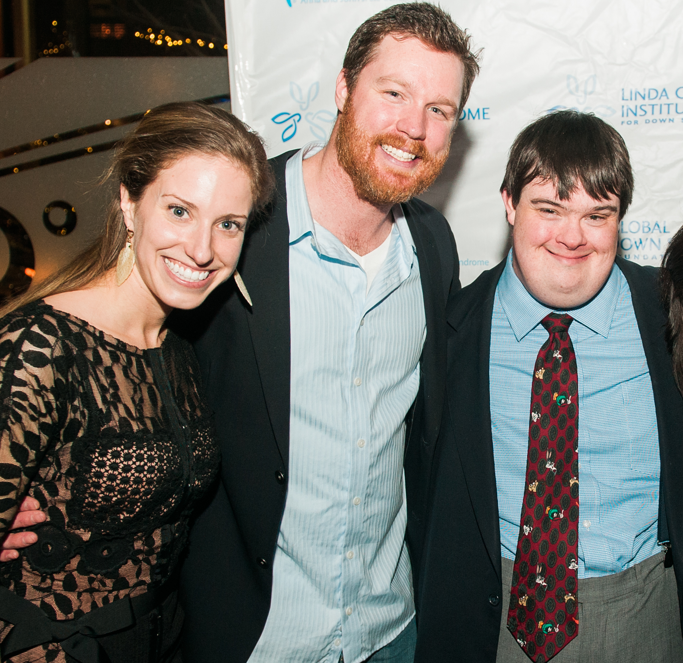
“es un mundo salvaje…” incluso en investigaciones básicas y ensayos clínicos.
Considere el riezgo y los beneficios de este estudio.
El aspecto más importante es el bienestar de sus seres queridos.
Gracias por su tiempo
Notes:
When it comes to…

