Slide 1





Scientific research in the INCLUDE era
New discoveries and clinical trials to improve heath outcomes in Down syndrome
Joaquin M. Espinosa, PhD
Executive Director
Adult Down
Syndrome Clinic

Slide 2


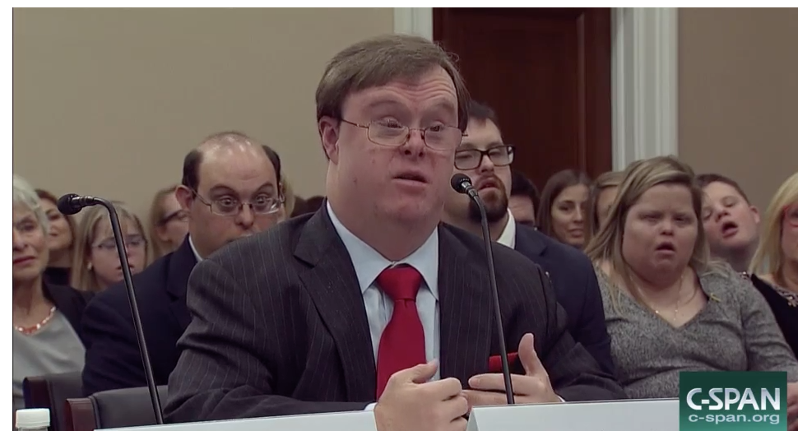
The NIH INCLUDE Project
Investigating co-occurring Conditions across the
Lifespan to Understand Down syndromE
Frank Stephens testifying in Congress

Slide 3
The NIH INCLUDE Project
What is the impact on the
scientific community?
Many new ideas from scientists across diverse disciplines
Many new synergistic collaborations
Strong recruitment and training of new talent
‘Translation’ of discoveries into clinical trials to test new therapeutic strategies

Slide 4

People with Down syndrome have a different ‘disease spectrum’
Cancer
Heart Disease
Coronary Artery Disease
Atherosclerosis
Hypertension
Angiopathies
(e.g. diabetic retinopathies)
Alzheimer’s
Autoimmunity
Leukemia
Autism, Seizures,
Congenital Heart
Defects
Autoimmune Disorders
(e.g. T1D, Celiac Disease, Hashimoto’s, Vitiligo, Rheumatoid Arthritis ) and more…
The ~6 million human beings alive today with trisomy 21
may hold solutions to many major medical conditions

Slide 5







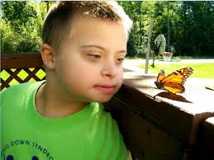


Each one of them is dealing with trisomy 21 in their own unique, personal way
They are more awesome than different,
yet they are ALL unique
Our motto:
Nothing in the study of Down syndrome makes sense except
in the light of Personalized Medicine

Slide 6
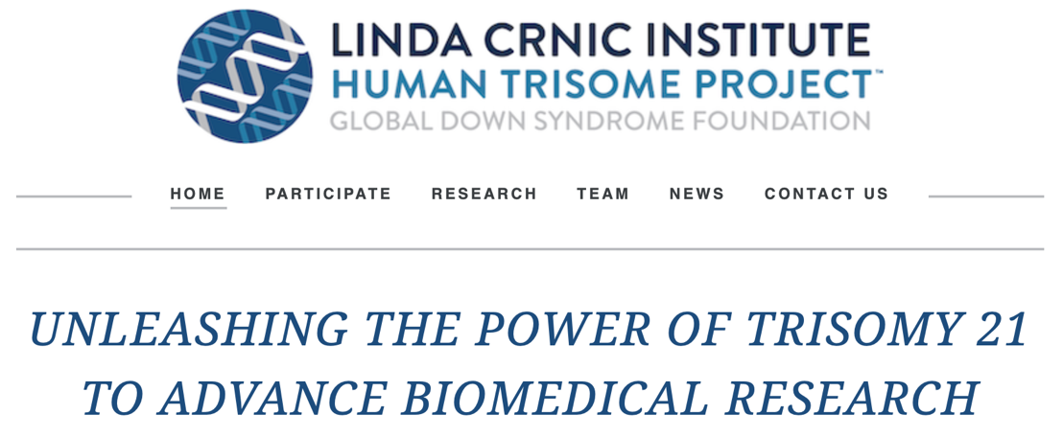
The Crnic Institute’s
Human Trisome Project
A large and detailed cohort study of people
with Down syndrome
www.trisome.org
HTP@ucdenver.edu

Slide 7
The Crnic Institute’s
Human Trisome Project
A large and detailed cohort study of people
with Down syndrome
Goals:
To enable a personalized medicine approach for the management of Down syndrome in the clinic.
To enable the design of novel diagnostic and therapeutic tools to improve health outcomes in Down syndrome.

Slide 8
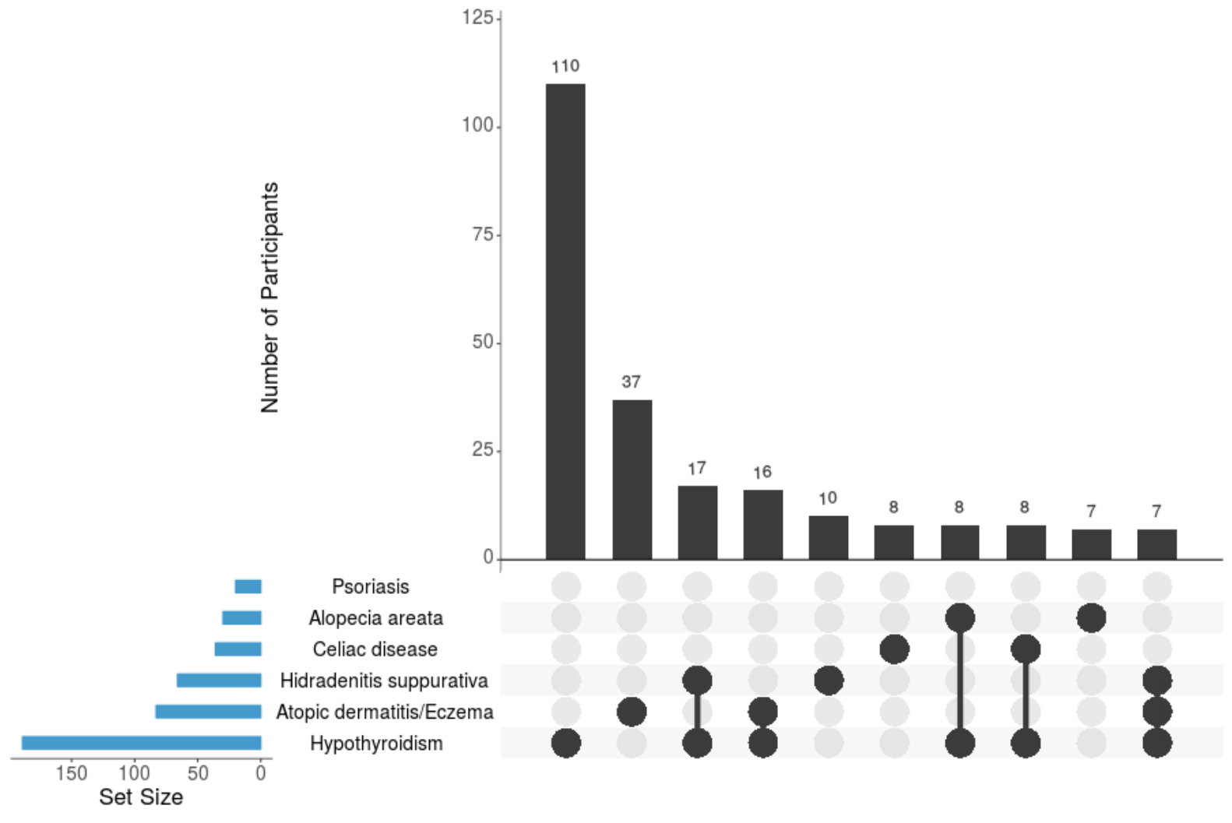
Key observation from the HTP:
widespread autoimmunity in Down syndrome
>60% of adults with Down syndrome
have been diagnosed with one or more
autoimmune conditions in their lifetime
That is >6-fold more than
observed in typical people
People with Down syndrome are affected by many autoimmune conditions

Slide 9
Key observation: widespread autoimmunity in
Down syndrome
The immune system of people with Down syndrome
is ‘dysregulated’
The immune system of people with Down syndrome is
mistakenly attacking healthy tissues, such as the
thyroid gland, the skin, and the intestines.
What other tissues may be undergoing
inappropriate ‘immune attack’?
What explains this immune dysregulation
in Down syndrome?
Is there a way to stop this autoimmune attack?

Slide 10
Trisomy 21 activates the Interferon response
People with Down syndrome show a hyperactive ‘Interferon response’
The Interferon response is a key aspect of the immune system that ‘interferes’ with viral infections
The Interferon response acts throughout the entire human body
Without an Interferon response, we would probably die within days of a common viral infection
Too much Interferon response is known to cause autoimmunity
People with Down syndrome are ‘fighting off’ viruses 24/7,
even when there is no virus present

Slide 11
Trisomy 21 activates the Interferon response
T cells
People with Down syndrome show a hyperactive interferon response

Slide 12


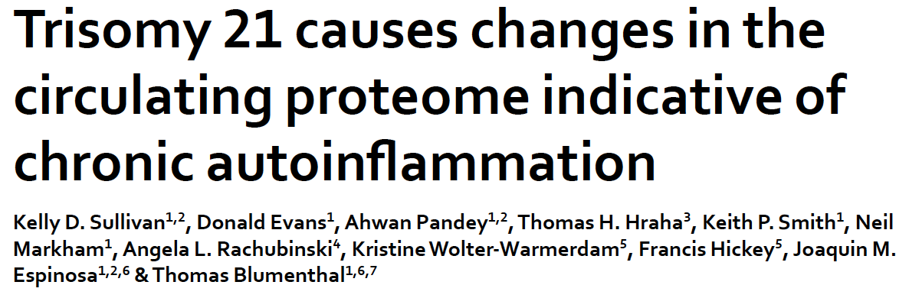
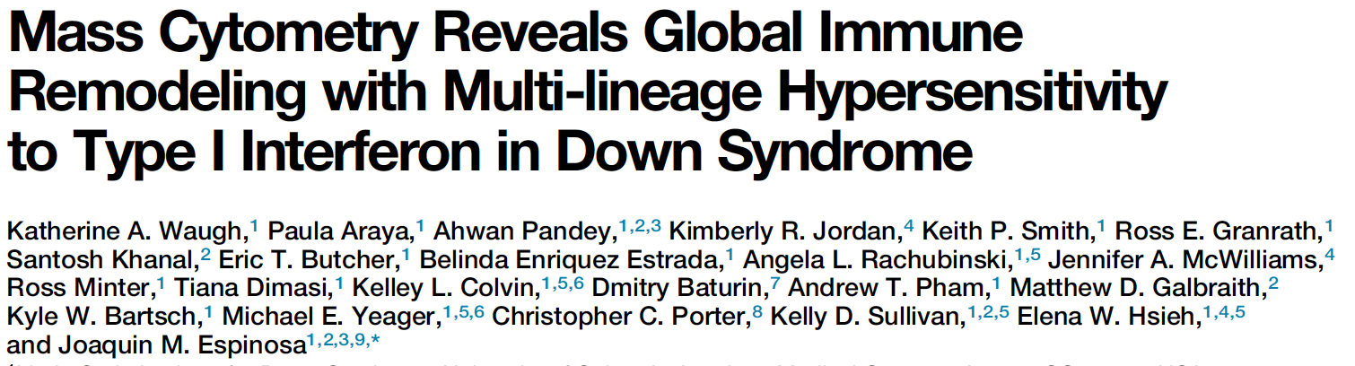



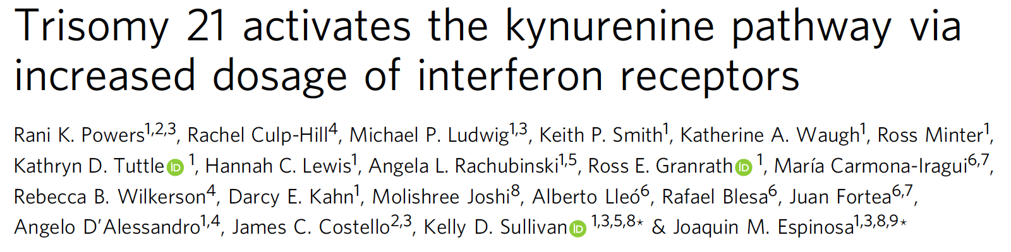
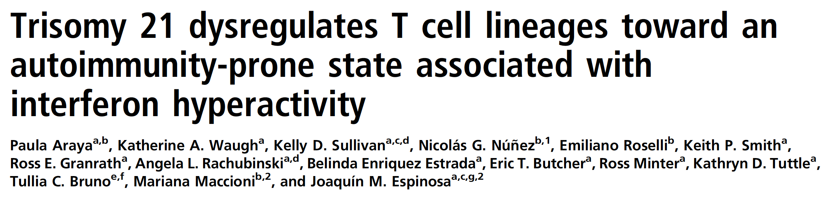


Peer reviewed publications
2016
2017
2019
2019
2019

Slide 13
Is there a way to ‘normalize’ the
Interferon response in
people with Down syndrome?

Slide 14




FDA-approved therapies that decrease the
Interferon response: JAK inhibitors
Company | Marketed Name | Target | Indication
 |  | JAK1&2 | Myelofibrosis (2011), polycythemia vera (2011), GVHD (2019)
 |  | JAK1&3 | Rheumatoid arthritis (2012), psoriatic arthritis (2017), ulcerative colitis (2018)
 |  | JAK1&2 | Rheumatoid arthritis (2018)
 |  | JAK1 | Rheumatoid arthritis (2019)
Also currently in clinical trials for Interferon-driven conditions more common in people with Down syndrome, including:
Alopecia areata
Atopic dermatitis
Depression
Hidradenitis suppurativa
Juvenile idiopathic arthritis
Leukemia
Vitiligo

Slide 15
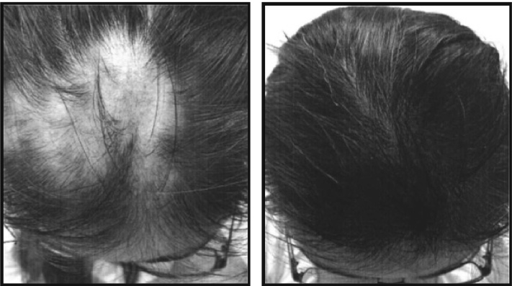
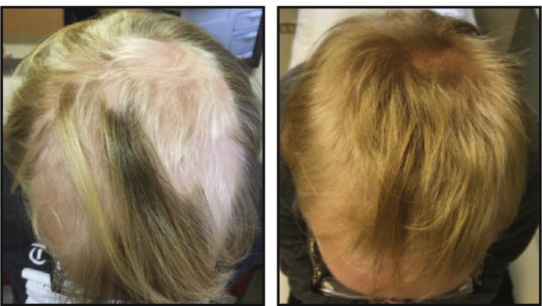
Off-label use of Tofacitinib for alopecia areata in Down syndrome
1 month
3 months
Before Rx
2 months

Slide 16
The first clinical trial for JAK inhibition
in Down syndrome
For immune-driven skin conditions:
    Atopic dermatitis
    Alopecia areata
    Hidradenitis suppurativa
    Psoriasis
    Vitiligo
Treated with Tofacitinib (aka Xeljanz) for 4 months
Safety as the primary endpoint
While also monitoring:
    Markers of immune dysregulation in the blood
    Impacts on other autoimmune conditions
    Impacts on cognition and quality of life

Slide 17
Scientific aims of the first JAK inhibitor clinical trial in Down syndrome
Aim 1: Define the safety profile.

Slide 18
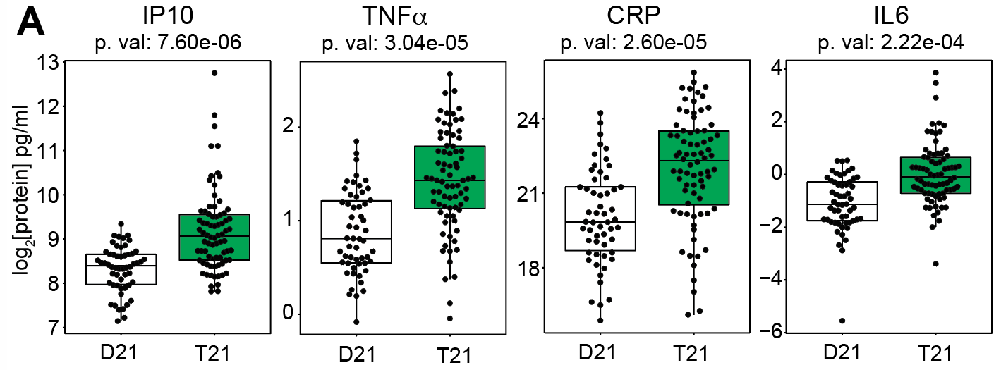
Scientific aims of the first JAK inhibitor clinical trial in Down syndrome
Aim 1: Define the safety profile in Down syndrome.
Aim 2: Determine the impact on immune dysregulation.
Many ‘inflammatory markers’
elevated in Down syndrome

Slide 19
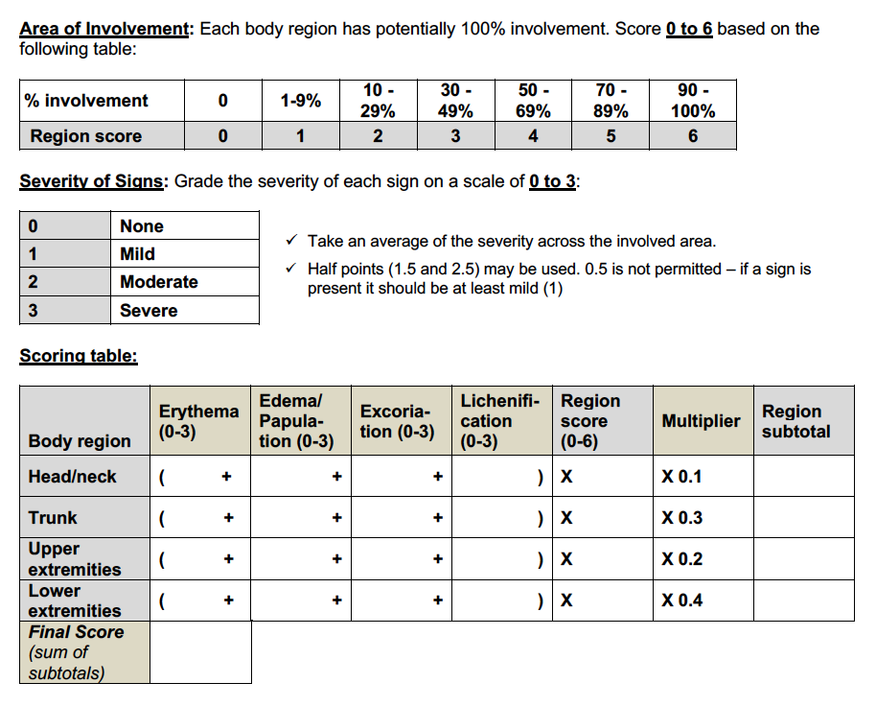
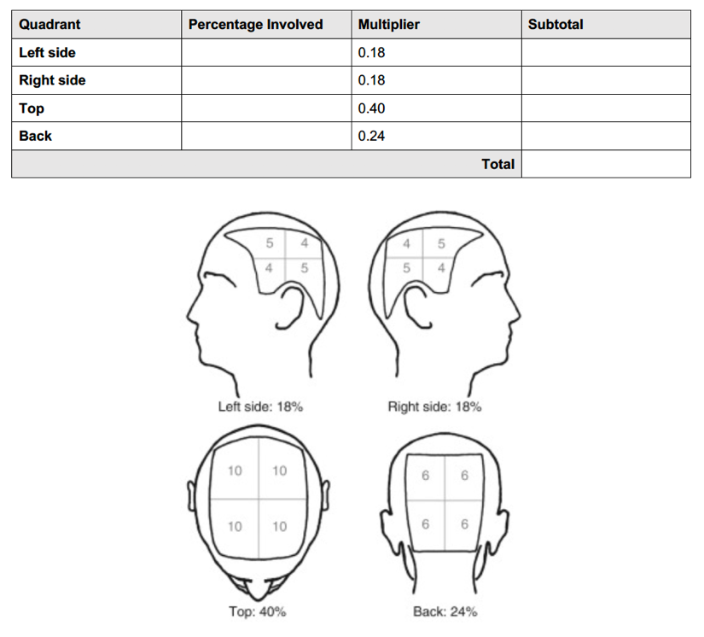
Scientific aims of the first JAK inhibitor clinical trial in Down syndrome
Aim 1: Define the safety profile in Down syndrome.
Aim 2: Determine the impact on immune dysregulation.
Aim 3: Define the impact on immune skin conditions.

Slide 20

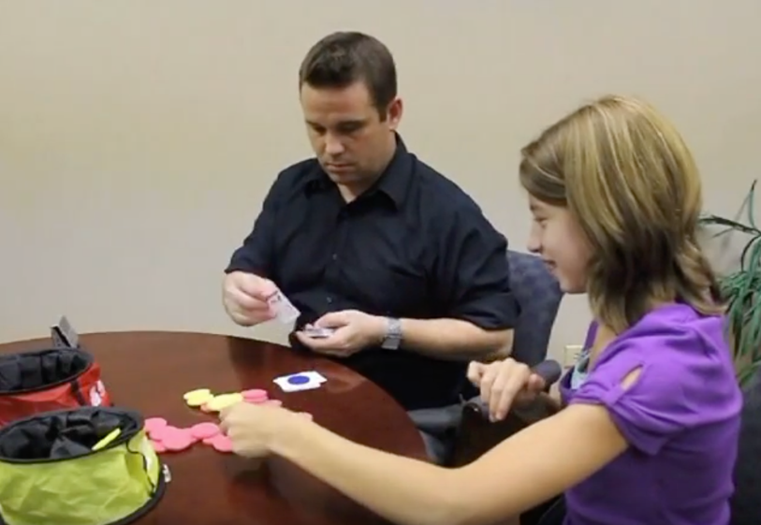
Scientific aims of the first JAK inhibitor clinical trial in Down syndrome
Aim 1: Define the safety profile in Down syndrome.
Aim 2: Determine the impact on immune dysregulation.
Aim 3: Define the impact on immune skin conditions.
Aim 4: Characterize the impact on cognition and quality of life.
Deborah Fidler, PhD
Professor and Interim Department Head
Human Development and Family Studies
Colorado State University

Slide 21

Important information
Funded by the National Institute of Arthritis
and Musculoskeletal and Skin Diseases (NIAMS)
through the INCLUDE Project
IRB-approved and listed in Clinicaltrials.gov:
https://clinicaltrials.gov/ct2/show/NCT04246372
Important dates:
Pre-screening by phone starts in March 2020
Screening and enrollment of first 10 participants planned for
between April and September 2020
Contact information:
joaquin.espinosa@cuanschutz.edu
Angela Rachubinski, PhD 303-724-7366
Belinda Enriquez-Estrada (Spanish) 303-724-0491
DSresearch@ucdenver.edu

Slide 22
Thanks!
All the wonderful individuals with Down syndrome
and their families who participate in research

